Slide 1

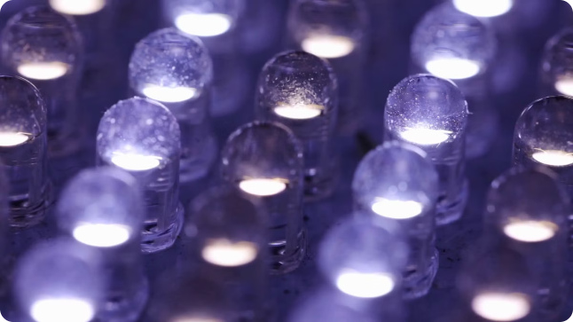

Introduction to LED Lights
LEDs are semiconductor devices that emit light when an electric current flows through them. They are energy-efficient and have a long lifespan compared to traditional incandescent bulbs.
by Swaraj kumar

Slide 2
Cathode and Anode in LED Lights
Cathode
Anode
The cathode is the negative terminal of an LED. It is usually the shorter leg and is connected to the negative terminal of the power supply.
The anode is the positive terminal of an LED. It is usually the longer leg and is connected to the positive terminal of the power supply.

Slide 3

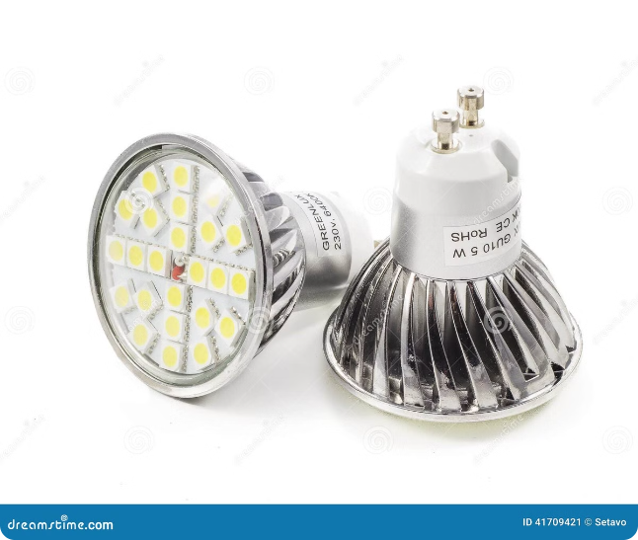
Difference Between Cathode and Anode
1
Polarity
2
Electron Flow
The cathode is negative, while the anode is positive. This polarity is essential for the LED to light up.
Electrons flow from the cathode to the anode, creating a current that excites the semiconductor material.
3
Light Emission
The cathode is where electrons are released, and the anode is where they are collected, allowing light to be emitted from the LED.

Slide 4
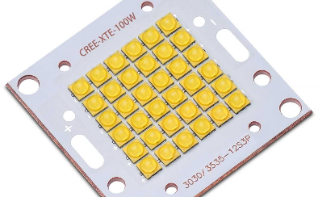


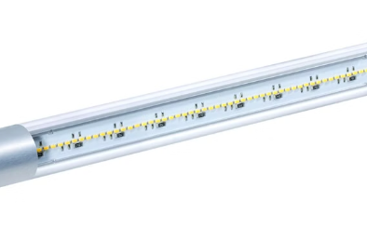
LED Light Image and Its Components
LED Chip
Lens
Epoxy
Contacts
The heart of the LED, where light is generated.
Focuses and directs the light emitted by the LED chip.
Protects the LED chip and lens from damage.
Provide electrical connections to the LED chip.

Slide 5


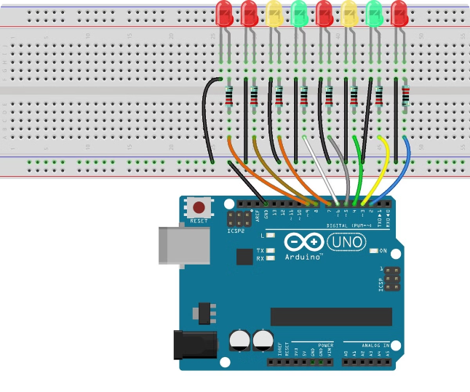


Connecting LED Lights to Arduino
Connect the LED's Anode
Connect the longer leg of the LED to a digital output pin on the Arduino board.
Connect the LED's Cathode
Connect the shorter leg of the LED to a resistor, and then connect the other end of the resistor to ground on the Arduino board.
Select a Resistor
The resistor value will depend on the LED's forward voltage and current rating.

Slide 6

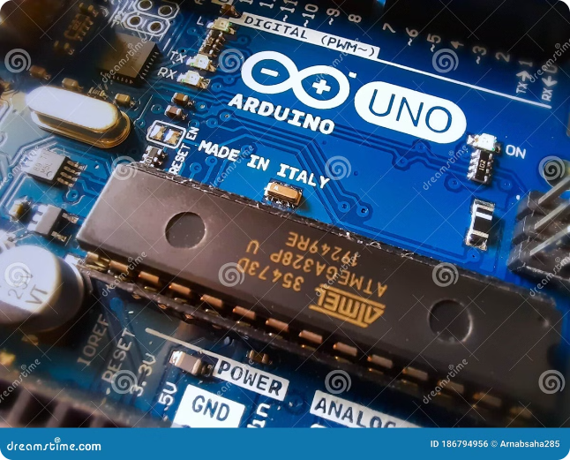
Working of LED Lights with Arduino
Arduino
LED
Resistor
Digital Output Pin
Anode
One End
Ground
Cathode
Other End

Slide 7

Working of LED Lights with Arduino
Arduino
LED
Resistor
Digital Output Pin
Anode
One End
Ground
Cathode
Other End

Slide 8
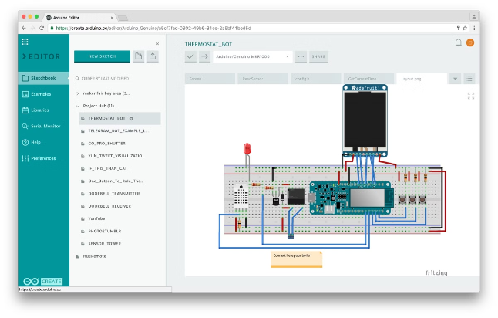
Arduino Code for Controlling LED Lights
const int ledPin = 13; // Define the LED pin void setup() { pinMode(ledPin, OUTPUT); // Set the LED pin as output } void loop() { digitalWrite(ledPin, HIGH); // Turn the LED ON delay(1000); // Wait for 1 second digitalWrite(ledPin, LOW); // Turn the LED OFF delay(1000); // Wait for 1 second }

Slide 9

Conclusion and Summary
LED lights are a versatile and efficient lighting solution. Understanding the cathode and anode is crucial for connecting LEDs correctly. With Arduino, you can easily control and program LEDs for various creative projects.

